Slide 1
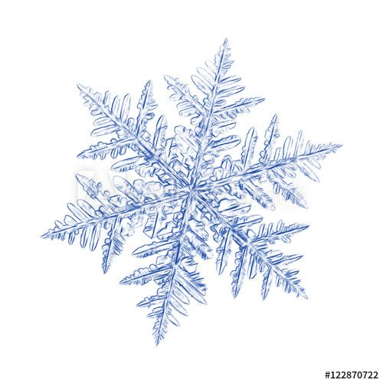
Snowball Earth
Earth and Climate Physics
Vincent van Roomen & Jeroen van Rijn

Slide 2
Introduction
Global glaciations 600-800 million years ago
Simulate ice sheet with energy balance model
Assume ice covered Earth from start
At what point in time does the ice sheet collapse?

Slide 3
Energy balance model
North/Bitz model
Includes changes to atmospheric concentration of CO2
Large timestep (e.g. 10.000 years) – adjust CO2 concentration
Smaller timestep (e.g. 1 week) – find equilibrium

Slide 4
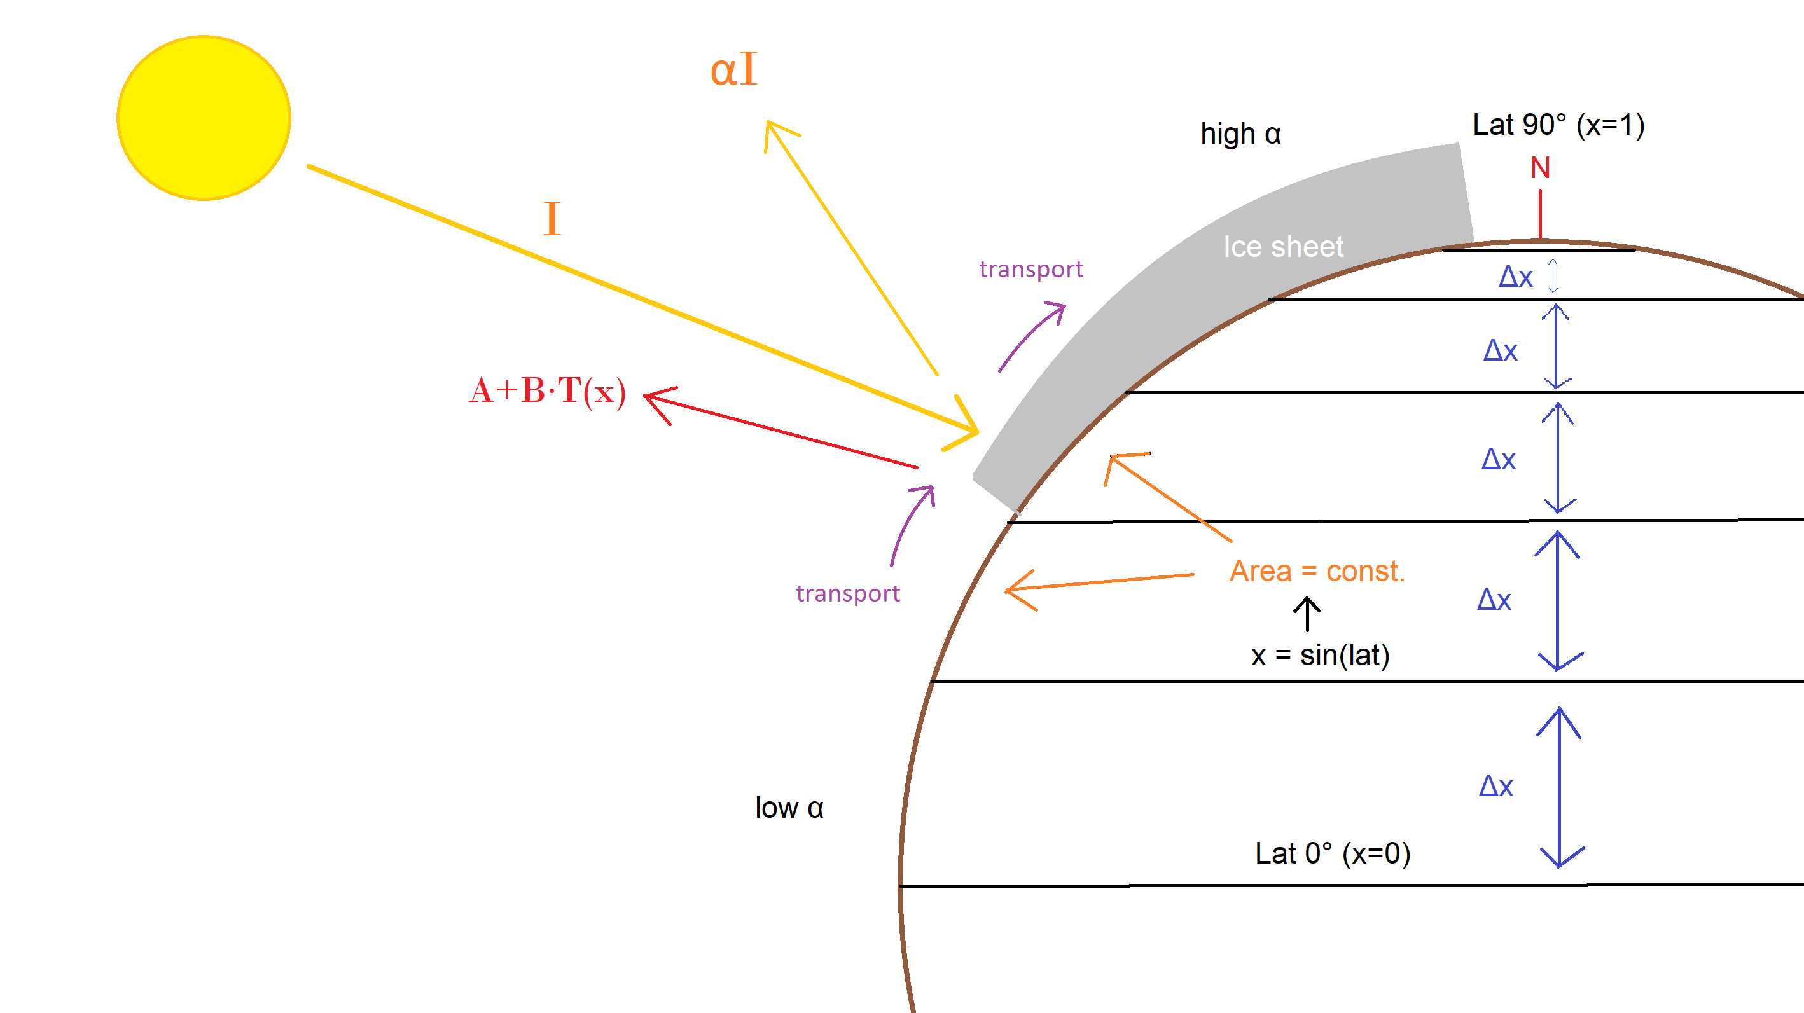
North model

Slide 5
Varying parameters
Increasing CO2
Initial value 170 ppmV, increase of 3.1e10 kgCO2 / year
Recalculating outgoing infrared radiation with parameterized function:
I = A + BT
Albedo
Simple model: α = 0.6 for snow, α = 0.3 for surface
Gradually increase dustcover of ice (from 0.18 < α < 0.65) over time
Solar insolation
Scaling factor of 0.94 compared to contemporary solar activity

Slide 6

Model flow diagram

Slide 7
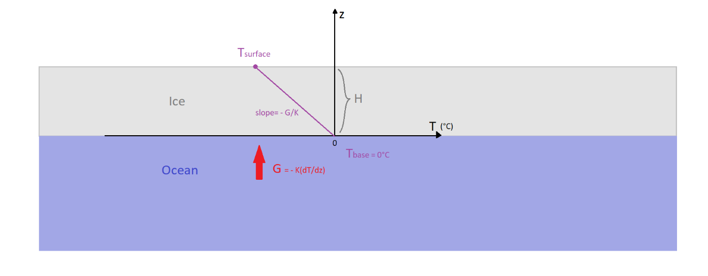
Ice sheet thickness calculation
Assumptions: the Earth is entirely an ocean, Ice sheet is static

Slide 8
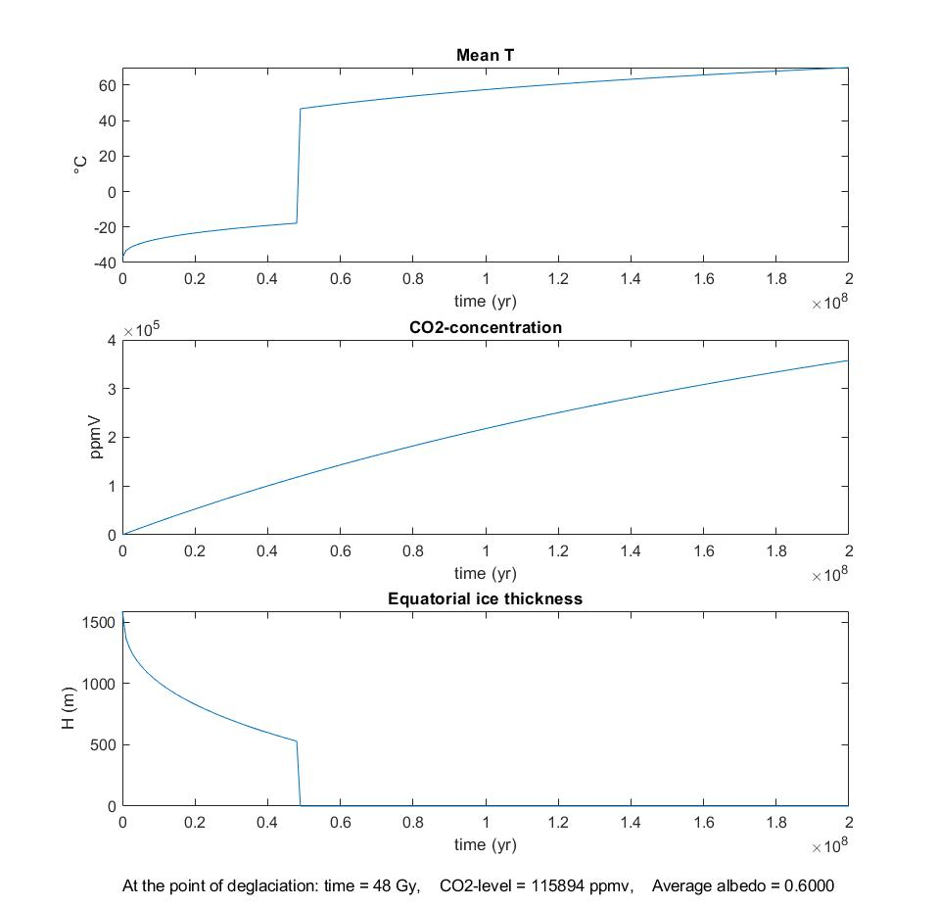
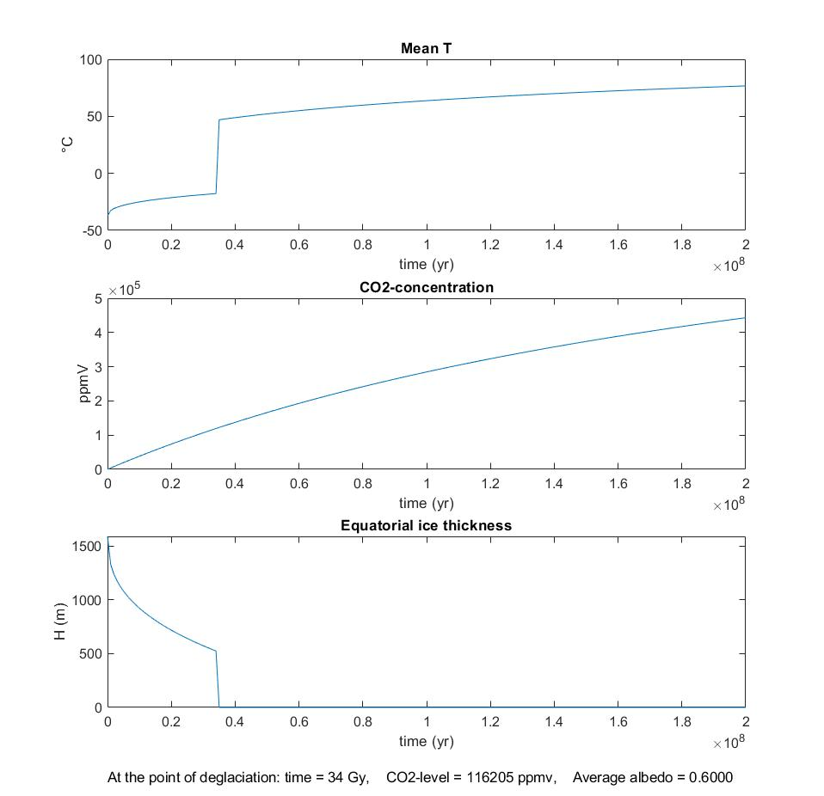
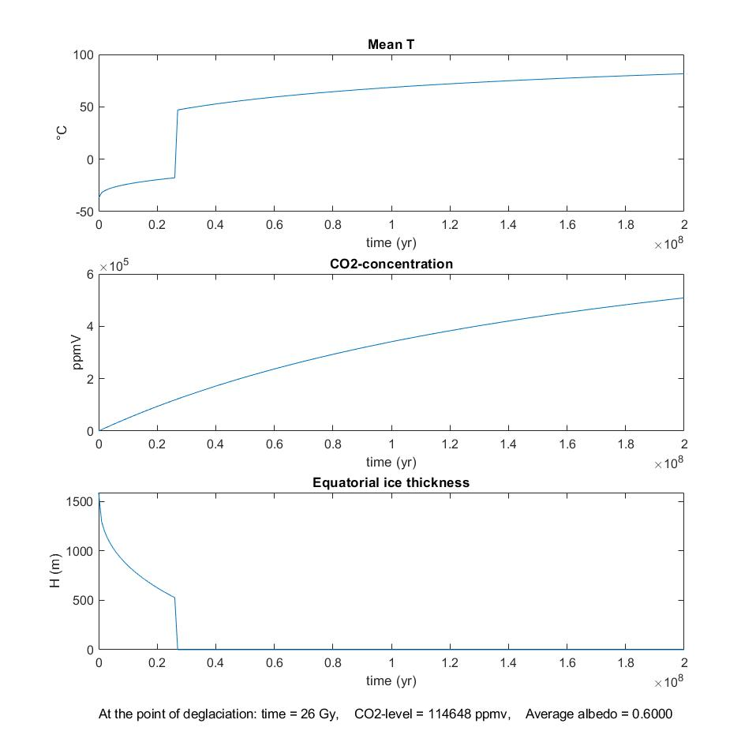
Increases of CO2 (0.7, 1, 1.3x)

Slide 9
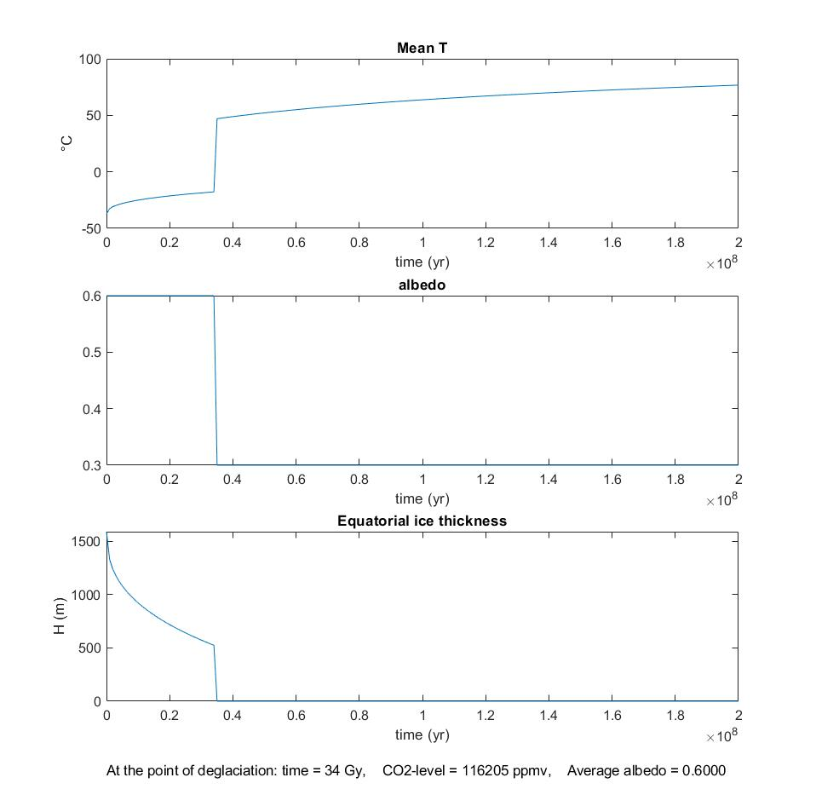
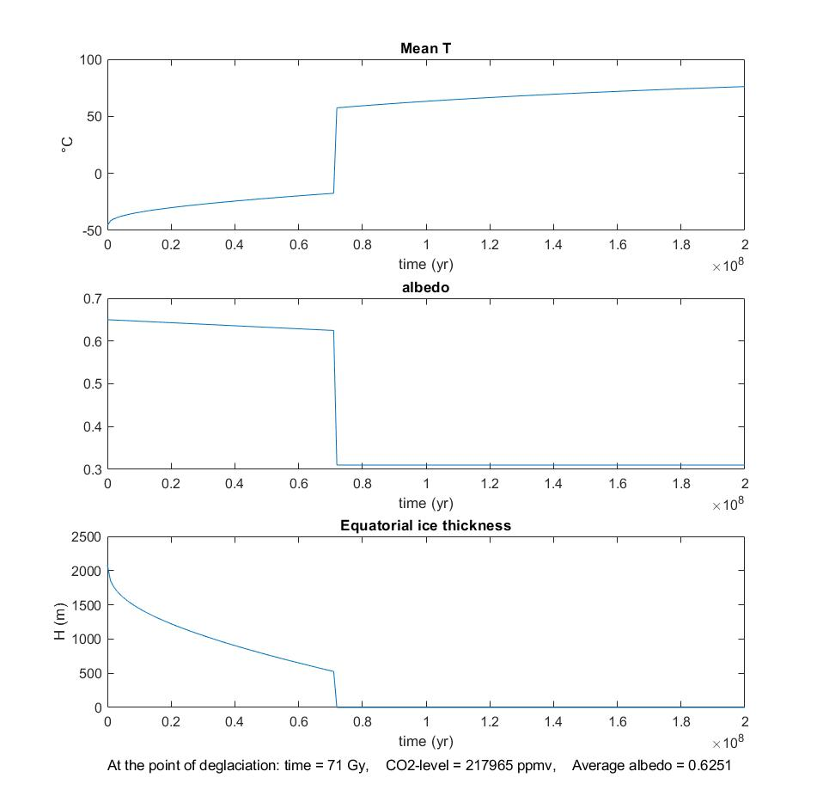
Constant and varying albedo

Slide 10
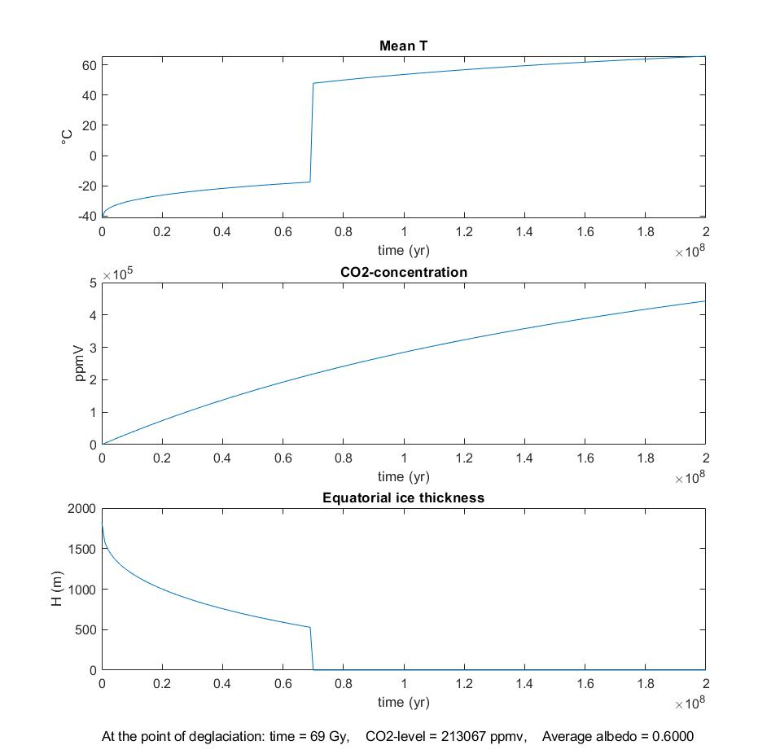
Present and ice age insolation

Slide 11
Preliminary Conclusions
Snowball Earth melts due to CO2 accumulation at: 34 Gy
116000 ppmV CO2
Including albedo changes due to dust: 71 Gy, 218000 ppmV
Taking into account the reduced solar activity: 69 Gy, 213000 ppmV
← Not a logical outcome

